Slide 1
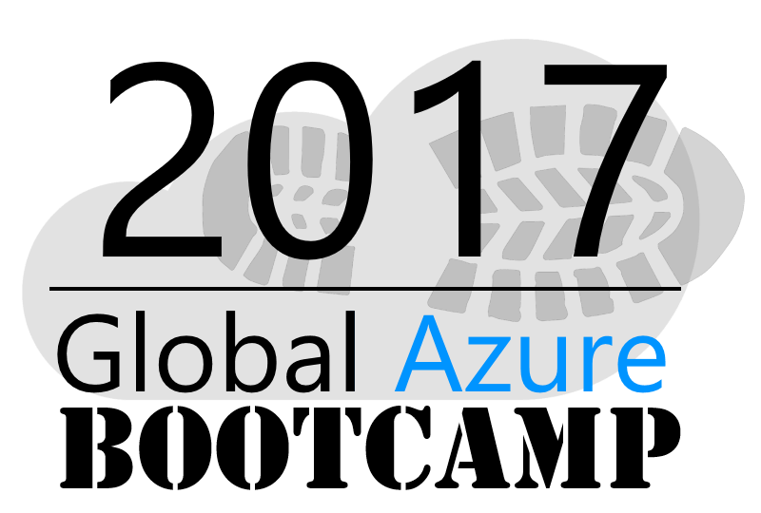
Welcome to the
MONTREAL

Slide 2

Welcome!

Slide 3






2017 Global Sponsors
Make sure to ask the organizers for the “Stuff We All Get” information!

Slide 4



Stuff We All Get
Sponsor | Offering
Cloudmonix https://cloudmonix.com/ | Cloudmonix offers 1 full month of unlimited monitoring under the Ultimate plan.
SentryOne http://www.sentryone.com/ | SQL Sentry offers an extended evaluation for every attendee.
ServiceBus360 http://www.servicebus360.com | Servicebus360 offers an extended license until September 30 for all attendees, and this for 3 namespaces, 3 alarms per namespace, 3 resources per namespace to monitor and 2 users.
OpsGility http://www.Opsgility.com | Opsgility offers a 30 day subscription free trial for all attendees.
Make sure to ask the organizers for the “Stuff We All Get” information!

Slide 5

Raffle Prizes
1 Winner: One license choosen from ReSharper, dotTrace Memory, dotTrace Performance, dotCover, dotPeek, PhpStorm, PyCharm, IntelliJ IDEA, AppCode, WebStorm, RubyMine
You’ll receive a voucher with a code from the organizers.
1 Winner: a 1 year license of DBSentry (formerly Performance Advisor for Azure SQL Database) for raffle per location.
Give your Full name and email to the Organizers
MyGet is offering a free Starter subscription for 1 year for 1 attendee per location.
Give your Full name and email to the Organizers
They offer 3 12-month subscriptions per GAB Location.
Give your Full name, email phone and company to the Organizers

Slide 6
Welcome Let’s get acquainted

Slide 7
Agenda
9h00-9h30 Intro + Portail Azure
9h30-10h15 Web Apps
10h15-11h00 Azure Storage
11h00-11h15 PAUSE
11h15-12h00 Les Fonctions Azure
12h00-12h45 LUNCH
12h45-13h15 Microsoft Cognitive Services
13h15-14h15 DocumentDB
14h15-14h30 PAUSE
14h30-15h15 Monitoring avec App Insights
15h15-16h00 DevOps

Slide 8
Goal
Cette journée sera centrée sur la pratique (20% théorie, 80% pratique).
Tout au long de la journée, vous bâtirez une application Web roulant sur Azure et utilisant une multitude de services Azure le tout en "live coding" en suivant les instructions des conférenciers.

Slide 9
Step 0 Intro + Portail Azure
Alexandre Brisebois
Technical Solutions Professional, Azure
http://alexandrebrisebois.wordpress.com

Slide 10
Goal
Getting to know Azure and the Portal

Slide 11
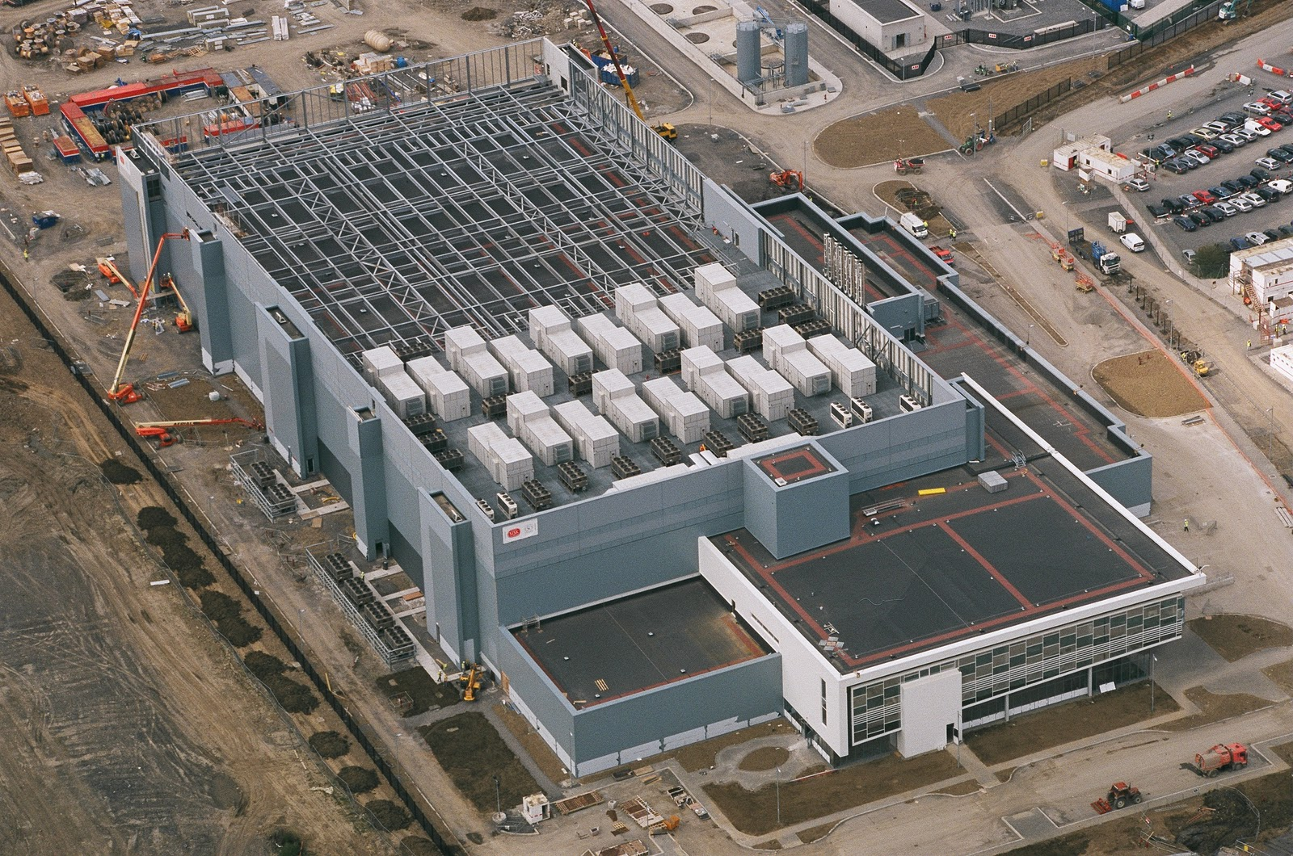
Notes:
This is what we think of when we hear the word “Datacenter”

Slide 12

Achieve global scale, in local regions
Trust
38
Azure regions
RECENTLY LAUNCHED:
US Regions: West US 2 and West Central
Germany – Launched in Sep 2016
United Kingdom – Launched in Sep 2016
NEWLY ANNOUNCED:
France: France Central and France South
Korea: Korea Central and Korea South
DoD East and Central
Notes:
At the core of Azure is its global infrastructure that spans 38 regions worldwide. We have the largest footprint of any cloud provider.
https://azure.microsoft.com/en-us/regions/
https://azure.microsoft.com/en-us/regions/services/

Slide 13
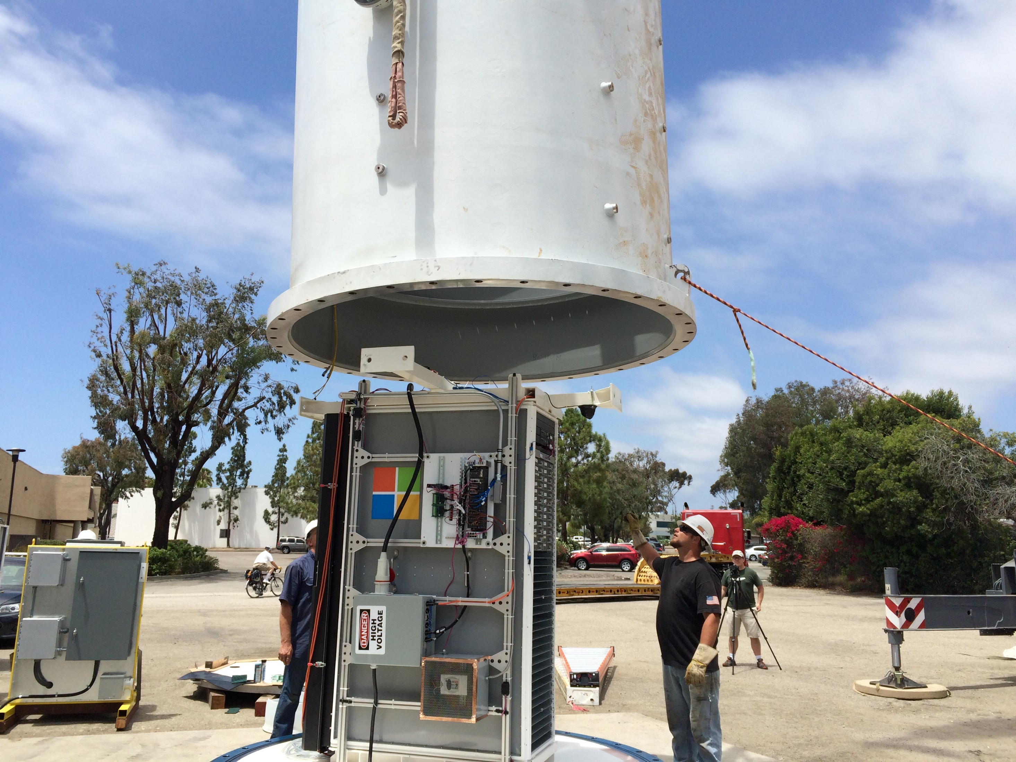
Notes:
My kids will probably hold a very different images of what a data center is. Microsoft Research is actively working on new approaches to bring resources online with more agility and proximity.

Slide 14
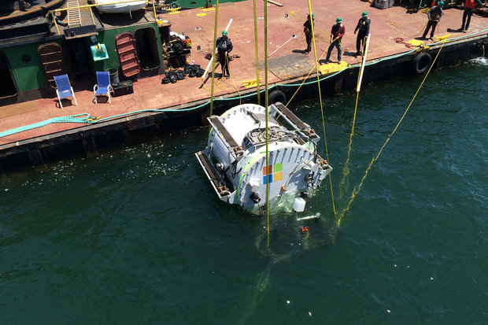
Notes:
Con’t

Slide 15
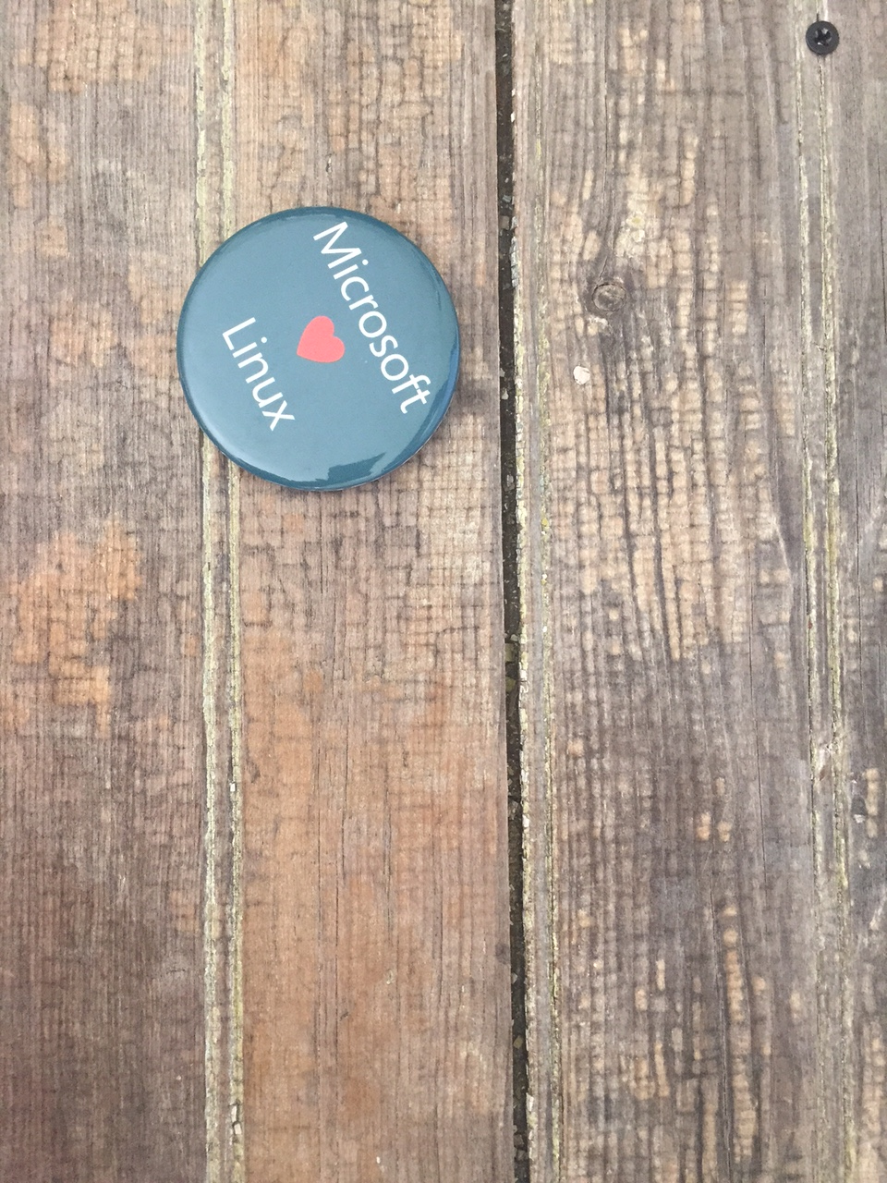
Notes:
Azure isn’t about Windows, its about enabling you to achieve more. Microsoft is undergoing a tremendous transformation and Linux/ Open Source Software is part of it. In a second we will dive in and I want you to remember that Microsoft is now the number contributor to OSS on GitHub and that some of the offered services are built and operated on Linux.
One of these services is the Azure SDN (Software Defined Network)
http://www.datacenterdynamics.com/content-tracks/servers-storage/microsoft-runs-azure-networking-on-linux/94837.fullarticle
Azure cloud uses Linux to handle data center networking - in a specialized software component developed by Microsoft to run conectivity within its cloud operating system, along lines set out by the Open Compute Project.

Slide 16
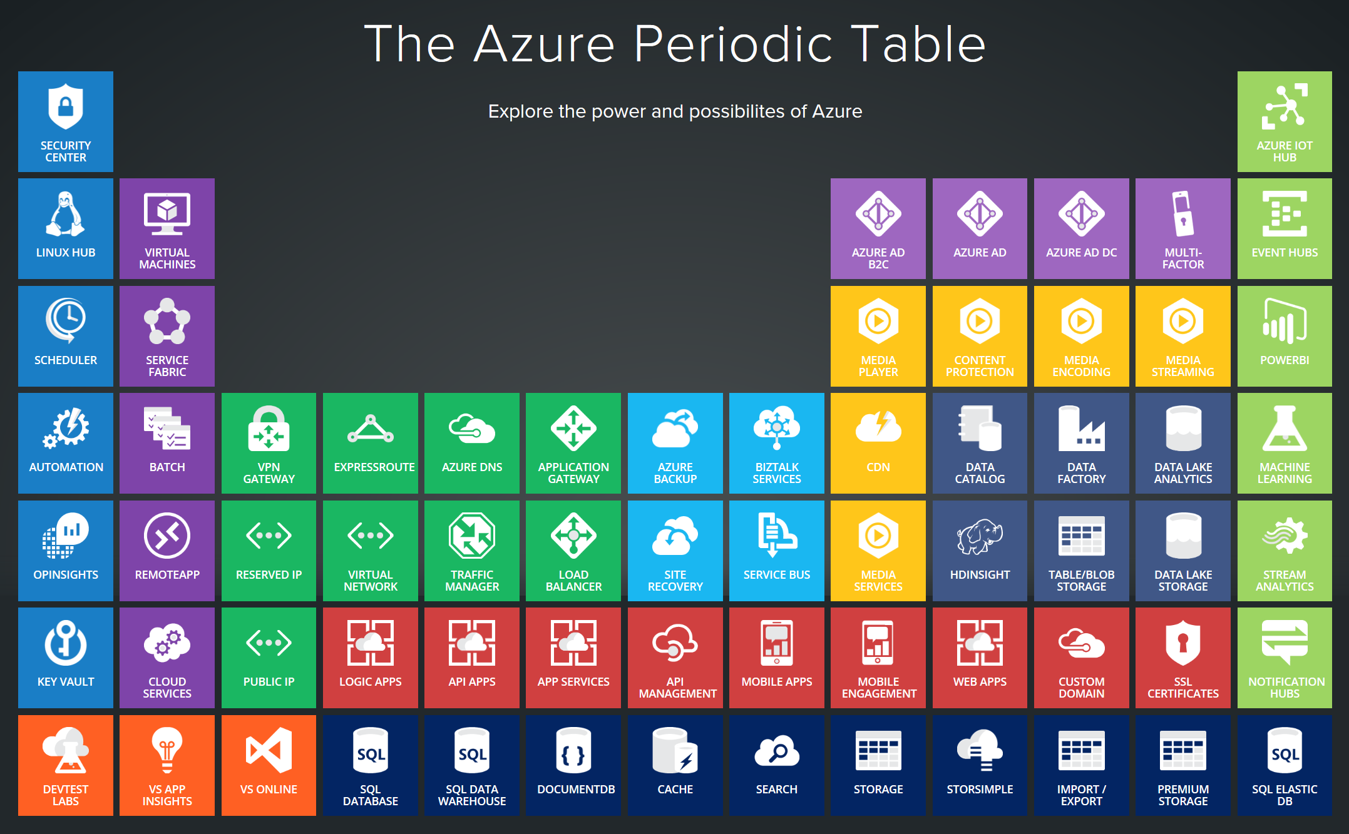
Notes:
Azure services support a multitude of scenarios from Infrastructure to platform services and extends your existing environments through various interconnectivity options. In today’s world, the level of sophistication required to innovate and compete requires us to be agile and adjust to a rapidly changing landscape. The cloud-only approach doesn’t work well for every scenario. Think about IoT and business critical workloads that drive delay sensitive manufacturing processes. Success comes from taking a hybrid approach and leveraging the cloud where it makes sense.

Slide 17
http://portal.azure.com
Notes:
Walk through the different sections, support tickets, azure market place, resource groups….

Slide 18
References:
Get started with Azure
Microsoft Azure Blog
Azure Updates
Cloud Platform roadmap
Azure Code Samples
Azure Quickstart Templates
AzureCAT Guidance
Cloud Design Patterns

